Slide 1
Reservation System for employees
Erik Boháč,Václav Vondráček

Slide 2
About us
Erik boháč
IT student at SPŠE Ječná
Third grade student
Email: bohac2@spsejecna.cz
Václav Vondráček
IT student at SPŠE Ječná
Second grade student
Email: vondracek@spsejecna.cz

Slide 3
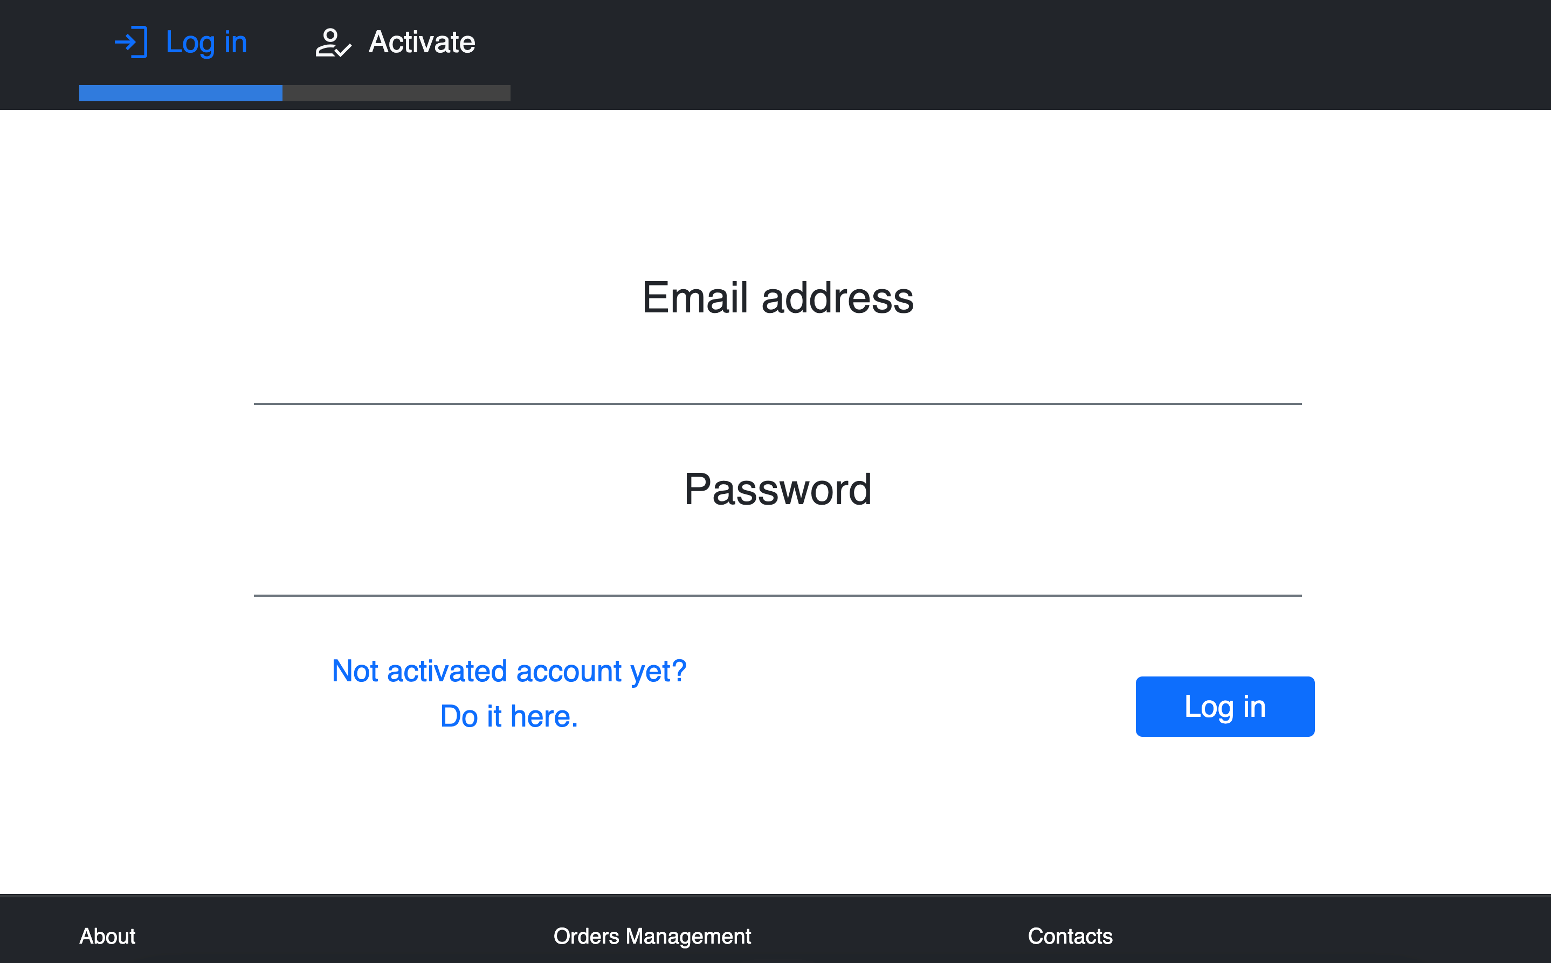
About the system
Reservation system
Reservation system for employees
Easy to use, simple layout
Responsive design
Available from website

Slide 4
Technologies we used
01
02
03
HTML & CSS
HTML – structuring content and define elements
CSS – enhancing visual appearance and layout
Javascript
Javascript with Emailjs for sending notifications to customers
Employee can simply send emails with one button click
PHP
Server-side processing
CSV interactions
04
CSV
Storing data
Manipulated with PHP

Slide 5
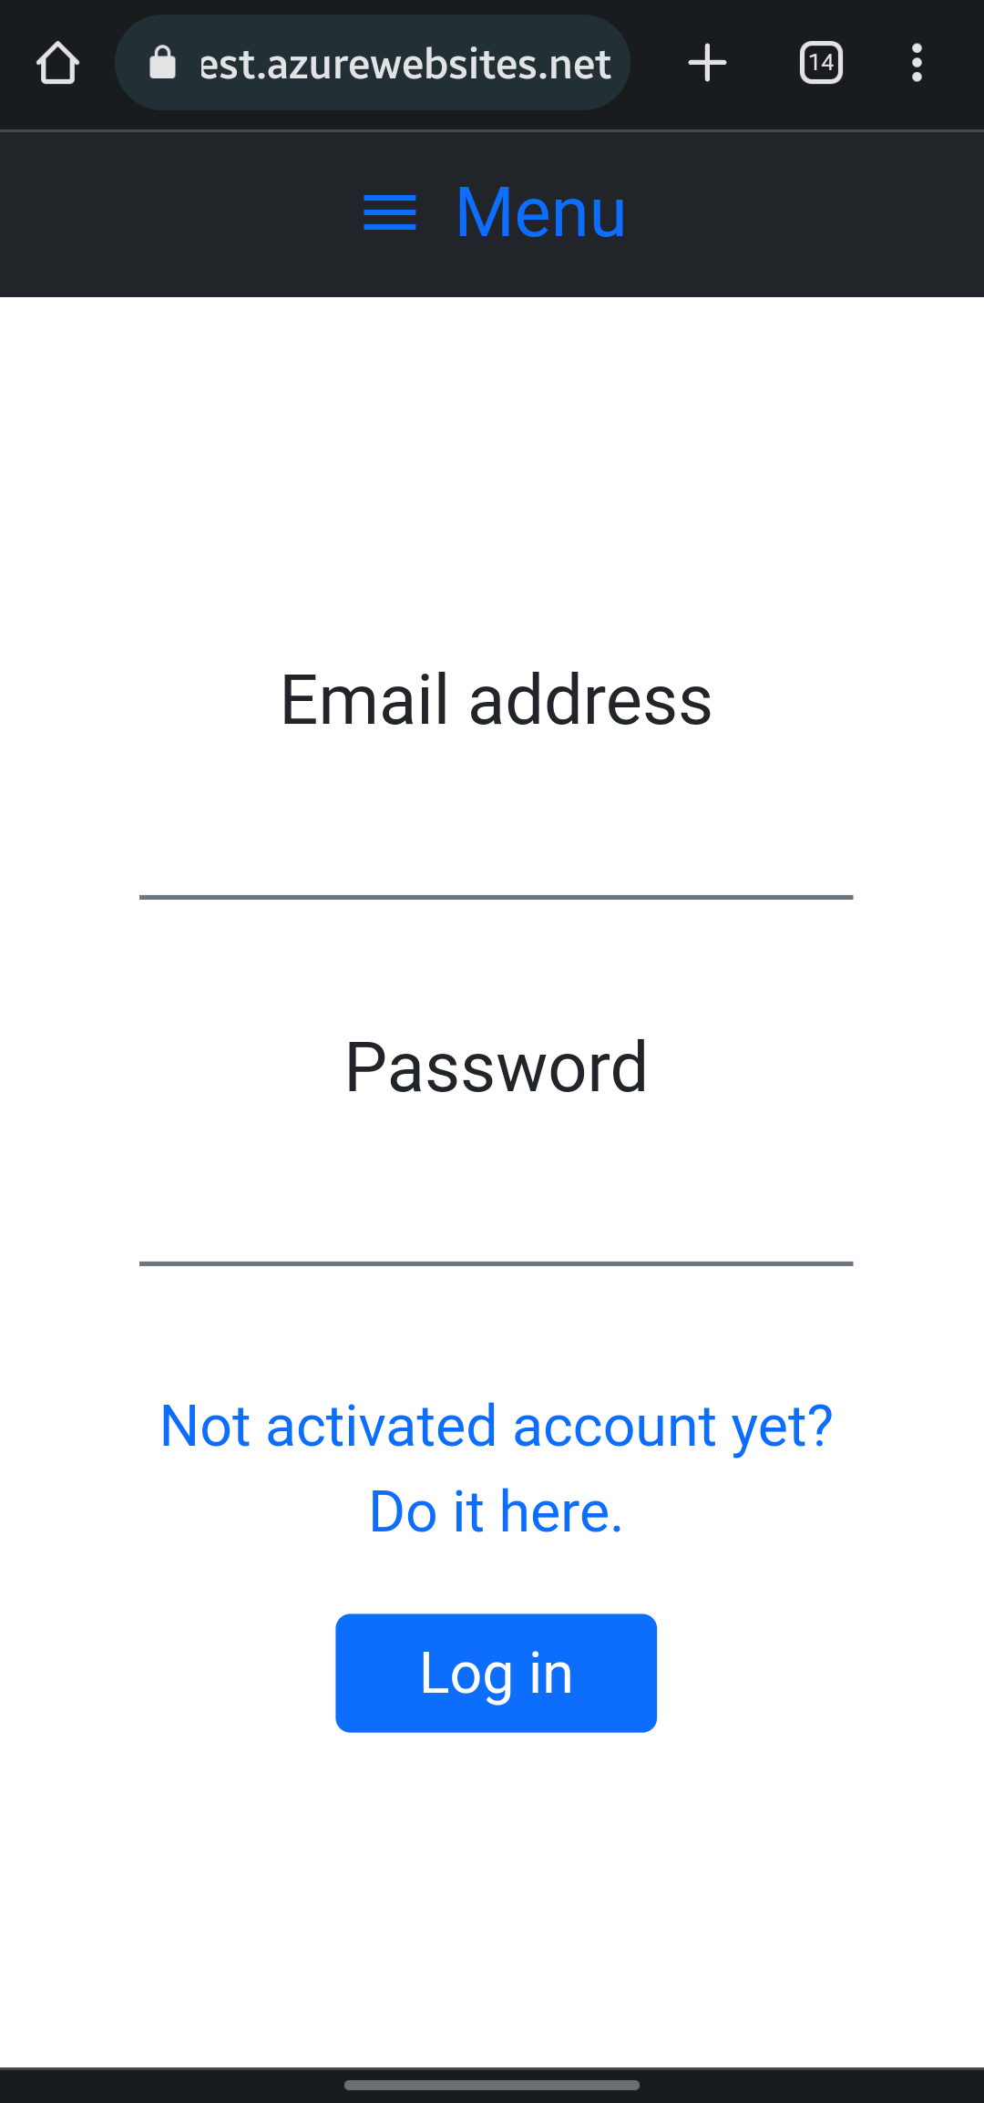
Account activation/Login system
Easy to use system
Employer can generate credentials for employees
Employees then have to activate their account

Slide 6
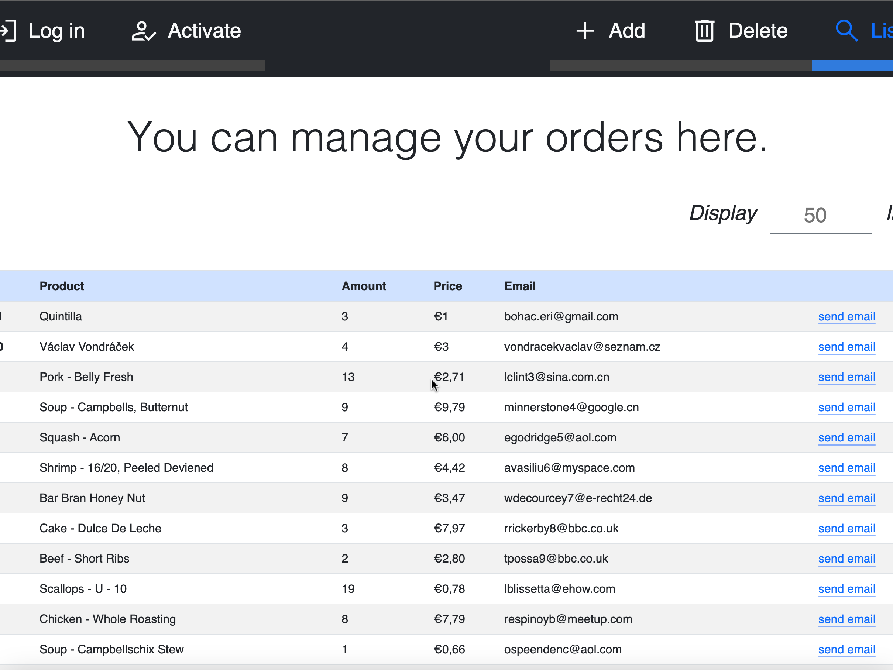
Managing reservations
Just log in
Choose how many lines do you want to see
See all information about orders
Send emails when orders are ready

Slide 7
Summary
05
Send email
Send notification to user
04
Search
View the full list
03
Add Reservation
Manually add new reservation
02
Login
With your credentials
01
Activate Account
Get credentials from employer

